Slide 1

DIGITAL DESIGN AND COMPUTER ORGANIZATION
Memory Operations
Instructions And Instruction Sequencing T2: Chapter 2: 2.3-2.4
Department of Computer Science and Engineering

Slide 2
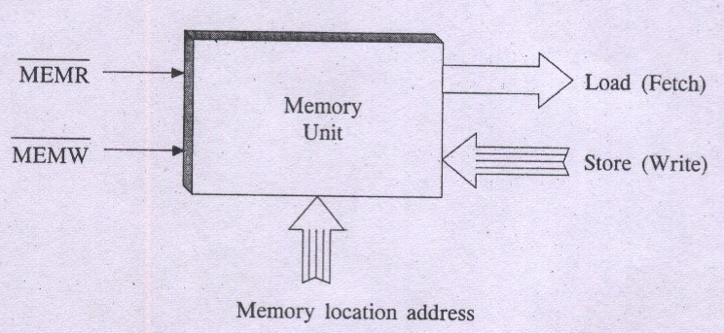
Memory Operations Introduction(T2 –section 2.3)
While executing a program, two distinct operations associated with Processor-Memory interaction are:
Load operation / Memory Read - (Instruction fetch / Operand fetch)
Store operation / Memory Write - ( Write computed results)

Slide 3
Memory Operations Load (Read Or Fetch)
Transfers a copy of the contents of a specific memory location to the processor
Processor sends address of the desired location to memory and requests that its contents be read(Issues read signal)
Memory reads the data and sends it to the processor
Memory contents remains unchanged

Slide 4
Memory Operations Store Or Write
Transfers an item of info from the CPU to a specific memory location, destroying the former contents of that location
Processor sends the address of the desired location to the memory, together with the data to be written
Issues write signal
Sends the data via data bus and write into the selected particular memory location

Slide 5
Instructions And Instruction Sequencing Introduction(T2 – section 2.4)
An instruction is a command to the processor to perform a given task on data operands.
A program is a set of instructions that specify operations, operands & the sequence by which processing has to occur.
Thus operation of a computer is controlled by stored program
In general a computer must support 4 categories of operations:
1.Data Movement : To conduct I/O transfers
2.Data Storage : Across Memory and processor registers.
3.Data Processing : Arithmetic and logical operations
4. Program sequencing and control : Test and Branch.

Slide 6
Register Transfer Notation
Data operands & Instructions are situated in main memory locations & processor registers.
Like mnemonics for Opcodes, Symbolic names or label identifiers are used to name or identify such locations.
For instances memory location names include M, LOC, A, B, C, SUM, N1, VAR1, VAR2, NUM1, etc.,
Similarly processor register names include R0, R1, R2, R3, R4, R5, etc., and registers of I/O subsystem may be designated as DATAIN, DATAOUT etc.

Slide 7
Register Transfer Notation
While depicting operations, the contents of a memory location or a register are denoted by placing the corresponding name in a pair of square brackets.
For instance : R0 ← [M]
Suggests to copy contents of memory location M to register R0
The corresponding instruction is MOVE M, R0,
Similarly : MOVE R1, SUM Suggests : SUM ← [R1]
The instruction : MOVE B, LOC Means : LOC ← [B]
Register
Memory Location
Register
Memory Location

Slide 8
Register Transfer Notation
Similar operations that involve Registers only are:
R1 ← [R2] MOVE R2, R1
R1 ← [R1] + [R3] ADD R3, R1
Suggest to add contents of register R1 and register R3 and rewrite the R1 contents to store the sum.
All such notations with leftward arrow (←) assignment operations involving register locations give rise to what is known as Register Transfer Notation

Slide 9
DIGITAL DESIGN AND COMPUTER ORGANIZATION
2. Assembly Language Notation T2:Ch2 2.4
Department of Computer Science and Engineering

Slide 10
Assembly Language Notation
An assignment statement in a High Level Language Program:
S = P + Q
Here P, Q & S are variables.
Variable name refers to symbolic address of memory location from which data operand can be read or written.
S ← [P] + [Q]
This operation suggests contents of two memory locations P and Q are fetched from memory and transferred into processor where sum of two numbers is performed. The resulting sum is then sent back to memory and stored in memory location S.
An instruction to this effect in Assembly Language Notation:
Add P, Q, S

Slide 11
Assembly Language Notation
Consider R1 ← [R1] + [R3]
Equivalent Assembly Language instruction is Add R3, R1.
Here the operation Code Mnemonic is Add
Register Locations R1, R3 represent operand fields
Similarly, in the instruction ADD R1, SUM
i.e. SUM ← [SUM] + [R1]
Opcode
Memory Operand
Register Operand

Slide 12
DIGITAL DESIGN AND COMPUTER ORGANIZATION
3. Basic Instruction Types T2:Ch2 2.4
Department of Computer Science and Engineering

Slide 13
Basic Instruction Types
Three – Address Instruction
Two – Address Instruction
One – Address Instruction
Zero – Address Instruction
Three – Address Instruction
Suppose we would like to use a single machine instruction to perform the following addition operation:
S ← [P] + [Q]
We will have to use a three – address instruction to carry out addition and to store the sum in a third variable S.
Then three address instruction to perform addition is:
Add P, Q, S

Slide 14
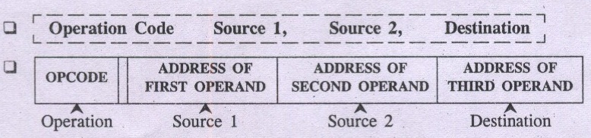
Basic Instruction Types General form of three – address instruction

Slide 15
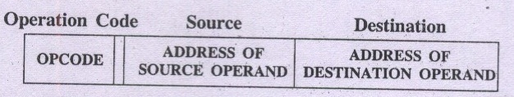
Basic Instruction Types Two – Address Instruction
Two – address instruction general format:
Example of two – address instruction Add P, Q
To perform operation of addition as : Q ← [P] + [Q]
Destination Operand
Source Operand/s

Slide 16
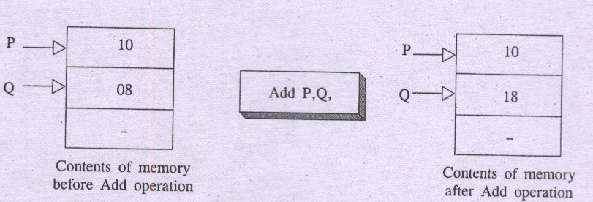
Basic Instruction Types
Here one of the operand i.e. destination operand Q acts as source as well as destination.
To perform S ←[P] + [Q]
Use two – address instructions sequence: MOVE Q, S ADD P, S

Slide 17
Basic Instruction Types One-Address Instruction
One –address instruction format specify a single operand along with operation code.
The requirement of second operand is fulfilled by an implicit processor register known as Accumulator (AC).
Example of one-address instruction: ADD Q
It Specify: AC ← [AC] + [Q]
Load P Suggest AC ←[P] (Fetch P into AC)
Store S Indicate S ← [AC] (Write AC into S)
To perform S ← [P] + [Q]

Slide 18
Basic Instruction Types One-Address Instruction
One –address instruction format specify a single operand along with operation code.
The requirement of second operand is fulfilled by an implicit processor register known as Accumulator (AC).
Example of one-address instruction: ADD Q
It Specify: AC ← [AC] + [Q]
Load P Suggest AC ←[P] (Fetch P into AC)
Store S Indicate S ← [AC] (Write AC into S)
To perform S ← [P] + [Q]
Use one – address instructions : Load P; AC ←[P]
Add Q; AC ←[AC] + [Q]
Store S; S ←[AC]

Slide 19
Basic Instruction Types Zero – Address Instruction
Stack – organized computer make use of a special memory structure called push down stack to store operands. In such computer machines it is possible to use instructions that contain only operation codes and no explicit operands.
The name Zero – address specifies the absence of an address field of operands in machine instructions.
Example of Zero – address instruction: ADD
To perform operation of addition as TOS ← (P + Q)

Slide 20
Basic Instruction Types
Mov A,Ri is equivalent
Load A,Ri
and
Move Ri,A is equivalent to
Store Ri,A

Slide 21
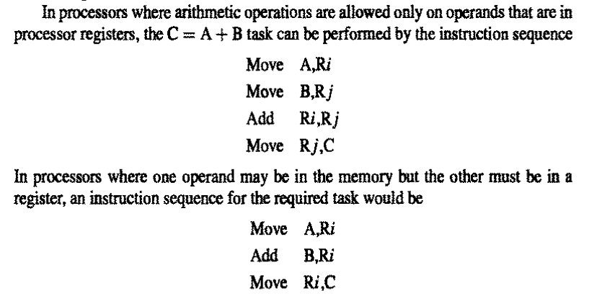
Basic Instruction Types
If processor supports ALU operations where one data may be in memory and other in register then the instruction sequence is for
ADD A,B,C :

Slide 22
DIGITAL DESIGN AND COMPUTER ORGANIZATION
4. Instruction Execution And Straight-Line Sequencing T2:Ch2 2.4
Department of Computer Science and Engineering

Slide 23
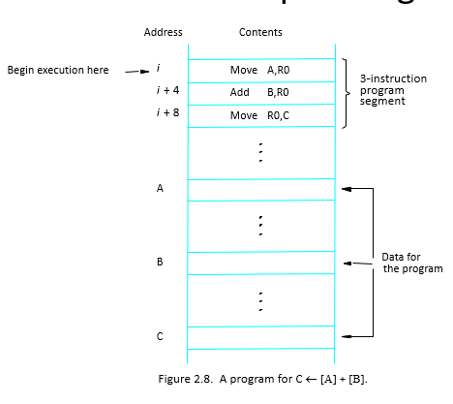
Instruction Execution And Straight-Line Sequencing
Assumptions:
- One memory operand
per instruction
- 32-bit word length
- Memory is byte
addressable
- Full memory address
can be directly specified
in a single-word instruction
Two-phase procedure
Instruction fetch
Instruction execute

Slide 24
Instruction Execution And Straight-Line Sequencing
PC – Program counter: hold the address of the next instruction to be executed
Straight line sequencing: If fetching and executing of instructions is carried out one by one from successive addresses of memory, it is called straight line sequencing.
Major two phase of instruction execution
Instruction fetch phase: Instruction is fetched from memory and is placed in instruction register IR
Instruction execute phase: Contents of IR is decoded and processor carries out the operation either by reading data from memory or registers.

Slide 25
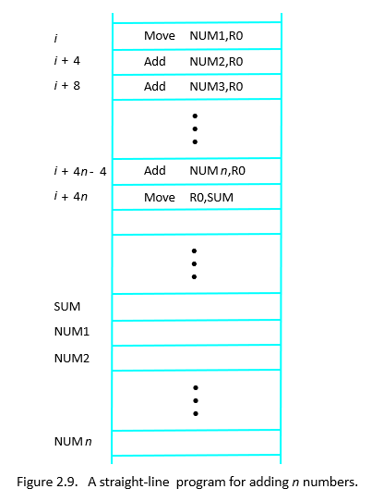
Instruction Execution And Straight-Line Sequencing

Slide 26
DIGITAL DESIGN AND COMPUTER ORGANIZATION
5. Branching T2:Ch2 2.4
Department of Computer Science and Engineering

Slide 27
Branching
Branch instruction are those which changes the normal sequence of execution.
Sequence can be changed either conditionally or unconditionally.
Accordingly we have conditional branch instructions and unconditional branch instruction.
conditional branch instruction changes the sequence only when certain conditions are met.
Unconditional branch instruction changes the sequence of execution irrespective of condition of the results.
Notes:
Unconditional-jump and goto

Slide 28
Branching
Consider branch instruction in a program:
Branch > 0 Loop
Program execution continues in a straight line sequence until encountering of Branch > 0 Loop instruction
Execution results in a jump to location of Loop.
That is a branch instruction loads a new value in PC - the memory location address (loop) at which program control is to be transferred to start/resume execution.
As a result processor is prohibited from fetching and executing next instruction in straight – line sequence.

Slide 29
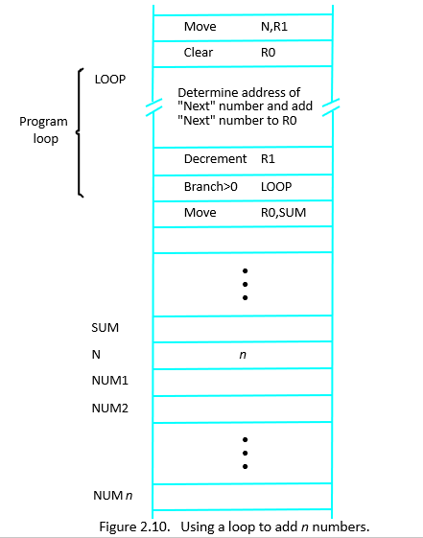
Branching
Branch target
Conditional branch

Slide 30
Branching
Check whether number Positive or negative
Move a,R0
Branch >0 Pos
Move R0,R2
Pos:
Move R0,R1

Slide 31
DIGITAL DESIGN AND COMPUTER ORGANIZATION
6. Condition Codes T2:Ch2 2.4
Department of Computer Science and Engineering

Slide 32
Condition Codes
The data conditions or status, after an arithmetic or logical operation are indicated by setting or clearing the flip – flops called flags or condition codes.
Each flip-flop holding a data condition code is a one –bit storage cell (logic circuit) that can be set to a 1 or reset to 0 value.
These condition codes are set/reset as a result of arithmetic and logical operations in the ALU.
Condition code bits or flag bits are accommodated in a groups of 4 – bit, 8 bit or 16 – bit flag register or a status register in CPU.

Slide 33
Condition Codes
Results of various instructions are stored for subsequent use by conditional instructions
This is done by recording the required info in individual bits, called as condition code flags – grouped together in special processor register called as condition code register or status register

Slide 34
Condition Codes
CONDITIONAL CODE FLAGS:
N – Negative 1 if results are Negative
0 if results are Positive
Z – Zero 1 if results are Zero
0 if results are Non zero
V – Overflow 1 if arithmetic overflow occurs
0 no overflow occurs
C – Carry 1 if carry from MSB bit
0 if there is no carry from MSB bit
Branch>0. Brach is taken when neither N or Z=1

Slide 35
Condition Codes
Pentium processor makes use of following condition codes:
C (carry flag)
P (parity flag)
A (Auxiliary carry flag)
Z (zero flag)
S (sign flag)
O (over flow flag)
Notes:
When an addition or subtraction causes a carry (or borrow) between the lower nibble (bits 0–3) and the upper nibble (bits 4–7), the Auxiliary Carry Flag (AC) is set to 1.
Otherwise, it is cleared (0).
The AC flag is mainly used for Binary-Coded Decimal (BCD) arithmetic corrections using the DAA (Decimal Adjust Accumulator) instruction in processors like the Intel 8085 and 8086.

Slide 36
Condition Codes
List the steps needed to execute the machine instruction Add LOC, R0 in terms of transfers between memory and processor and some simple control commands. Assume that the instruction itself is stored in the memory at location INSTR and that this address is initially in register PC.

Slide 37
Condition Codes
Transfer the contents of register PC to register MAR
Issue a Read command to memory, and then wait until it has transferred the requested word into register MDR
Transfer the instruction from MDR into IR and decode it
Transfer the address LOCA from IR to MAR
Issue a Read command and wait until MDR is loaded
Transfer contents of MDR to the ALU
Transfer contents of R0 to the ALU
Perform addition of the two operands in the ALU and transfer result into R0
Transfer contents of PC to ALU
Add 1 to operand in ALU and transfer incremented address to PC

Slide 38
Condition Codes
Repeat the problem for machine instruction
Add R1,R2,R3

Slide 39
Condition Codes
Transfer the contents of register PC to register MAR
Issue a Read command to memory, and then wait until it has transferred the requested word into register MDR
Transfer the instruction from MDR into IR and decode it
Transfer contents of R1 and R2 to the ALU
Perform addition of two operands in the ALU and transfer answer into R3
Transfer contents of PC to ALU
Add 1 to operand in ALU and transfer incremented address to PC

Slide 40
Condition Codes
Give a short sequence of machine instructions for the task: “Add the contents of memory location A to those of location B, and place the answer in location C.”
Instructions Load LOC, R_{i}
and Store R_{i}, LOC
are the only instructions available to transfer data between the memory and general purpose register R_{i}. Do not destroy the contents of either location A or B.

Slide 41
Condition Codes
Load A,R0
Load B,R1
Add R0,R1
Store R1,C

Slide 42
Condition Codes
Suppose that move and add instructions are available in the format
Move/Add loc1,loc2
Loci can be either memory or reg. Is it possible to use fewer instructions?
Give the seq

Slide 43
Condition Codes
Move B,C
Add A,C

Slide 44
DIGITAL DESIGN AND COMPUTER ORGANIZATION
7. Generating Memory Addresses T2:Ch2 2.4
Department of Computer Science and Engineering

Slide 45
Generating Memory Addresses
The instruction block at LOOP needs to add a different number from a list during each iteration.
The Add instruction must refer to a different memory address during each pass through the loop.
The memory operand address cannot be directly given in a single Add instruction because it would require modification on each pass.
A possible solution is to use a processor register, such as Ri, to hold the memory address.
Ri can be initialized with the address NUMI before the loop and incremented by 4 after each iteration to point to the next memory address.
This situation highlights the need for flexible ways to specify operand addresses.
These methods are known as addressing modes, which vary in implementation but share common underlying concepts across different computers.

Slide 46
Think about it
Write assembly code in three two and one address format for SUB A,B,C
Write assembly code in three two and one address format for A=B+C-D

Slide 47
MCQ
A processor executes instructions in straight-line sequencing unless:
a) A Load instruction is encountered b) A Store instruction is encountered c) A Branch instruction is encountered d) A Condition Code is set
Which condition flag is set to 1 if an arithmetic operation results in a value too large for the number of bits available?
a) Zero (Z) b) Carry (C) c) Overflow (V) d) Sign (N)

Slide 48
MCQ
A processor executes instructions in straight-line sequencing unless:
a) A Load instruction is encountered b) A Store instruction is encountered c) A Branch instruction is encountered d) A Condition Code is set
Answer: c) A Branch instruction is encountered Explanation: Branch instructions alter the normal program counter (PC) sequence
Which condition flag is set to 1 if an arithmetic operation results in a value too large for the number of bits available?
a) Zero (Z) b) Carry (C) c) Overflow (V) d) Sign (N)
Answer: c) Overflow (V) Explanation: Overflow flag is set when the signed result exceeds representable range

Slide 49
MCQ
Which one of the following instruction formats uses the accumulator (AC) implicitly as one operand?
Zero-address instruction b) One-address instruction c) Two-address instruction d) Three-address instruction
Consider the sequence of instructions:
Load P
Add Q
Store S
This corresponds to which instruction format?
a) Three-address b) Two-address c) One-address d) Zero-address

Slide 50
MCQ
Which one of the following instruction formats uses the accumulator (AC) implicitly as one operand?
Zero-address instruction b) One-address instruction c) Two-address instruction d) Three-address instruction
Answer: b) One-address instruction
Explanation: In one-address instructions, one operand is explicitly given, while the accumulator (AC) is the implicit second operand
Consider the sequence of instructions:
Load P
Add Q
Store S
This corresponds to which instruction format?
a) Three-address b) Two-address c) One-address d) Zero-address
Answer: b) One-address instruction
Explanation: In one-address instructions, one operand is explicitly given, while the accumulator (AC) is the implicit second operand
18. Consider the sequence of instructions:
Load P
Add Q
Store S
This corresponds to which instruction format?
a) Three-address
b) Two-address
c) One-address
d) Zero-address
Answer: c) One-address
Explanation: Only one explicit operand is specified in each instruction; the other operand is the accumulator

Slide 51
THANK YOU
Team DDCO
Department of Computer Science

